Slide 1
Media Relations Top 10
Anna Alfonso
Director, Marketing and Communications
Notes:
Good afternoon everyone. I’m Anna Alfonso, Director of Marketing & Communications at the Edmonton Public Library. In today’s webinar, I’ll guide you through the basics of media relations. This can take many forms, face to face, online, telephone and print. It can be both an exciting and daunting task for anyone, regardless of the role you have within your library. I’ll go through 10 tips to inform and support your approach to media relations.

Slide 2
What is Media Relations?
Media Relations involves working with media for the purpose of informing the public of an organization's mission, policies and practices in a positive, consistent and credible manner. Typically, this means coordinating directly with the people responsible for producing the news and features in the mass media.
Notes:
For our webinar today, we will be using this definition:
Media Relations involves working with media for the purpose of informing the public of an organization's mission, policies and practices in a positive, consistent and credible manner. Typically, this means coordinating directly with the people responsible for producing the news and features in the mass media.
Media relations - Wikipedia
https://en.wikipedia.org/wiki/Media_relations

Slide 3
Tip #1: Build Relationships
Notes:
By building relationships and rapport with reporters, producers and bloggers, it will increase the likelihood that your library stories will be told and shared through media coverage.

Slide 4
Build Relationships
What are they interested in?
Build a media list
Be a resource
Notes:
To build relationships, we need to understand what makes media tick.
What are they interested in?
Some magazines/publications like Parenting or the Arts section of your daily newspaper have a clearly defined target audience and interests while others talk to many different groups (e.g. TV News) so it is worth finding out what type of stories they are interested in and tailor your approach accordingly.
Build a media hit list. Prioritize the list. Who do you want to connect with? Work out which media reach your target audiences. Curate the list so that you can communicate effectively with everyone who is on it.
Be a resource.
One of the best ways to move beyond transactional media relations ("Will you cover my news?" "Can I have an interview?") is to be a resource to reporters for stories that are beyond your current priorities. Invest the time to help explain to reporters covering your industry on key issues, and “who’s who” in the industry. Be available to talk to them about general library stories that may not be specific to your library.

Slide 5
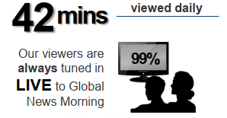
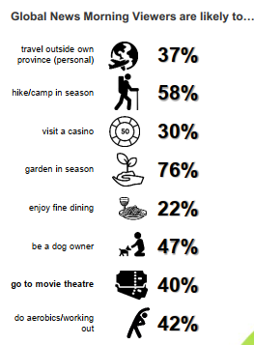
Build a media list
Media Outlet | Role | Name/ info | Interests | Audience Profile
News morning shows (ex. Global, CTV) | Producer |  | Family activities, events for Adults | *Adults 18+
Evening news (ex. Global, CTV, CBC) | Video journalist |  | Capital projects, Services that impact community
Art section - Newspapers (Journal, Herald) | Reporter |  | Speaker events, authors
Life style mags (ex. Avenue) | Editor, Reporter |  | Listicles, Local content
Parenting magazine | Editor, Reporter |  | Early literacy, education
Notes:
Here’s what the start of a media list could look like. Highlight the media outlet, who the person is and their role, interests and what audience to they reach.
This can be done in a simple spreadsheet.
If your budget allows, there are tools out there that can manage this for you as well such as Meltwater and Trendkite.
* Global News 2018 Audience Profile, Source: Numeris PPM Edmonton EM – Fall 2018

Slide 6
Tip #2: Proactive vs. Reactive Media Relations
Notes:
Media Relations can be defined as proactive or reactive.

Slide 7
Proactive vs. Reactive
Proactive Approach
Tied to your marketing plan
Review editorial calendar opportunities
Gain and maintain publicity
Reactive Approach
Follow-up on a story idea
Crisis media management
Notes:
Proactive Media Relations is advantageous – it’s when you are actively seeking opportunities to get your library seen or heard. With proactive media relations, you define your objectives, identify an audience early and establish the most effective ways to reach them.
This includes details such as: the community you’d like to engage, the tone of voice in which your library brand will speak consistently; the channels by which to communicate; and a number of specific dates on which it’s essential to address your audience.
As a first step, look at your marketing plan mark all of the points in the year when it’s essential that you communicate: Seasonal - Summer program for kids and adults, New program and services, the opening of a new branch, or a speaker event.
Consumer and trade Magazines have editorial calendars – review these does your library have content to contribute?
Note any relevant dates you can use as an opportunity for participation, including events where it’s possible to discuss topics that are important to your customers. Perhaps you want to share the special events you are hosting for library month,
Reactive: For many organizations, the common practice remains reactive when it comes to media relations. This is when media reach out to you to follow-up on a story idea they have or on something they have heard. Perhaps media saw a tweet about an event you are holding or a new resource that you have. If it interests them, they will follow up with you. And you’ll need to organize an interview. Important to have your spokespeople established. Because it is reactive and unplanned your go-to spokesperson may not be available so a back-up is needed.
Reactive media relations is also used for negative perception management, particularly in light of an event that has damaged the reputation of the organization.
.

Slide 8
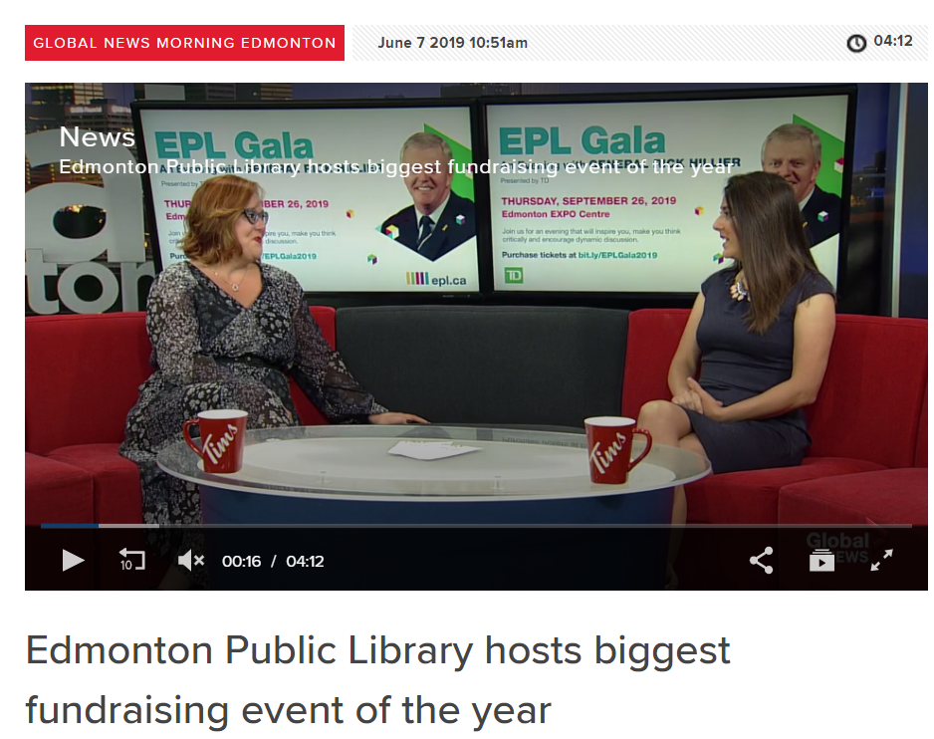
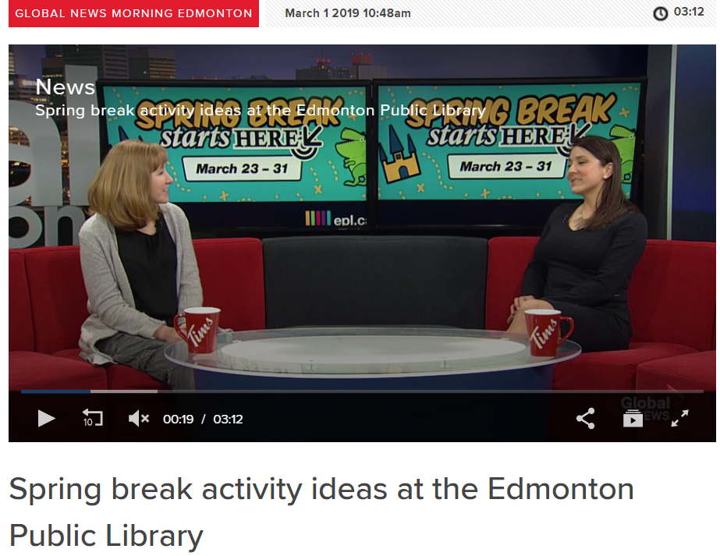
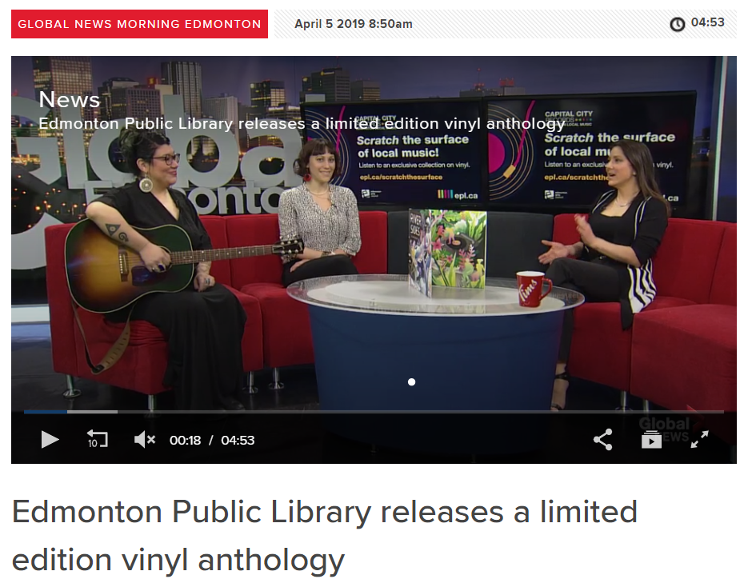
Proactive Media Relations
Notes:
Building relationships and being a resource has provided EPL this great opportunity on Global morning news. On the first Friday of the month, EPLers are interviewed on content that is relevant at that point in time. Content that is driven by our marketing plan. Top left is our CL chatting about Spring Break before the program launched, FD Manager sharing our EPL Gala news when the tickets went on sale and Capital City Records Artist Celeigh Cardinal with Digital Public Spaces Librarian being interviewed about EPL’s limited edition vinyl record.

Slide 9
Tip #3: Media Pitches
Notes:
Customize/Personalize your media pitches. Pitch individual journalists by email, phone. Connect through social media.

Slide 10
Media Pitches
DO’s
Target your efforts
Plan and prepare
Nurture your relationships
Notes:
The DO’s of media pitches.
1. Target your efforts.
Focus and tailor your pitch to a curated list of reporters, you have a better chance of earning media coverage.
2. Plan and Prepare.
When it comes to engaging potential prospects and media in real-time, all of the work doesn’t happen in the moment. It requires planning. Put together monthly, quarterly and yearly strategies that encompass media relations, campaigns and content plans.
3. Nurture your relationships. Be aware of media’s timelines, and deadlines.
Create a spokesperson chart so you know who the “Go To’s” are in your library when it comes to media interviews. Perhaps CEO for Capital Projects, budget, new services. Community Librarians for new programs and classes. And assign back up spokespeople.

Slide 11
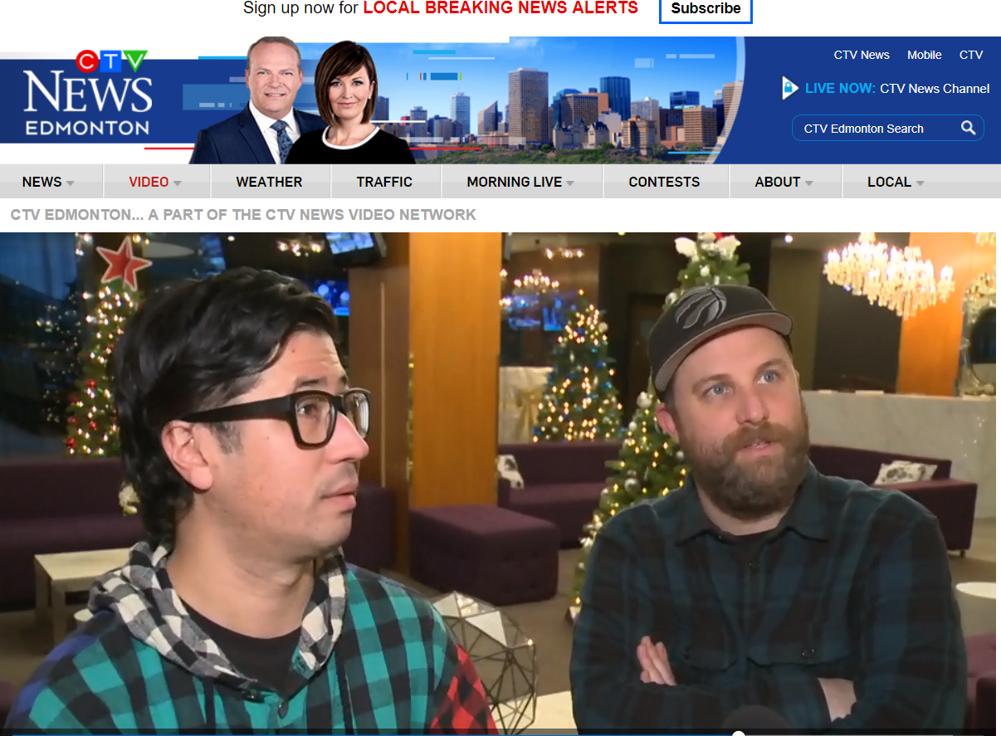
Media Pitches
Notes:
Example: Targeted entertainment reporter Graham Neil to cover FTSS featuring Choir Choir Choir.

Slide 12
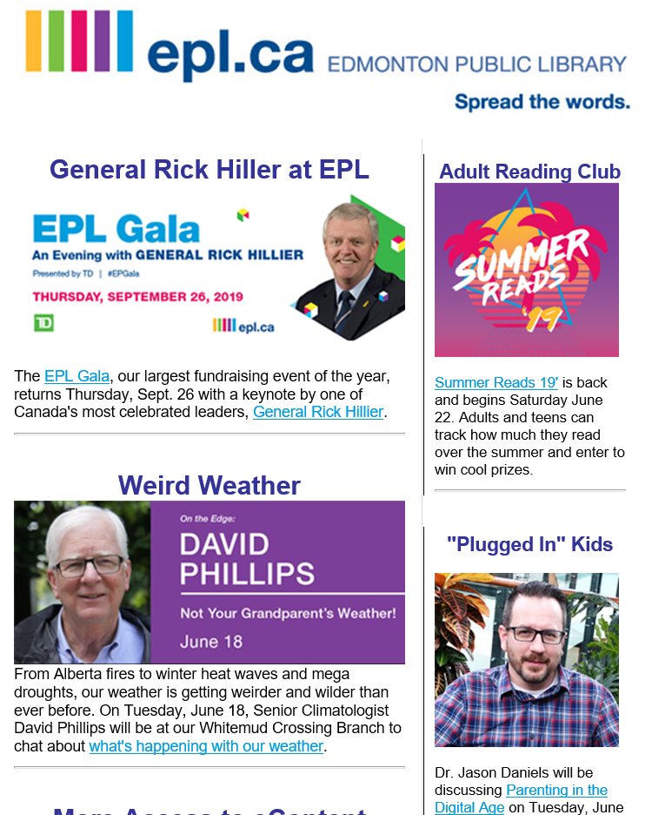
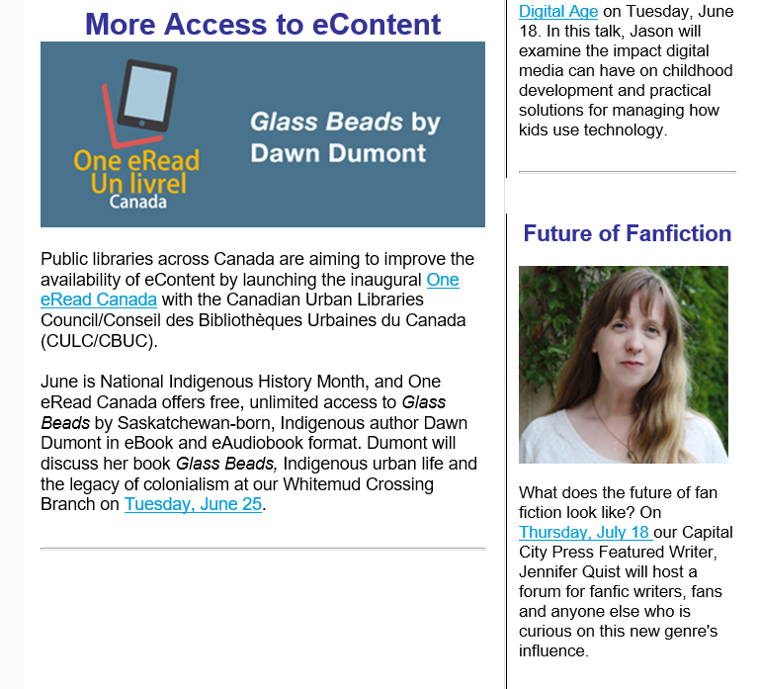
Media e-Newsletter
Notes:
EPL’s media e-newsletter is sent out to media contacts every three weeks. When we are curating the content, we ask is it media worthy? Is there a story here? Who could be interviewed?

Slide 13
Media Pitches
DON’Ts
Use cookie cutter pitches
Include heavy attachments
Forget to proofread
Notes:
DON’Ts
Don’t Use cookie cutter pitches
Target your pitches to the audience – what are they interested in?
Don’t Include heavy attachments
When drafting your messages, make sure to avoid adding heavy attachments. Media outlets receive lots of pitch emails every day and large attachments will only discourage journalists from downloading them and learning more about your pitch.
Also, you never know what sort of regulations are placed on company email inboxes – some don’t allow attachments weighing more than 5MB. And you wouldn’t want your email turned back just because of that.
Don’t Forget to proofread
Ensure that your pitch – media release, media advisory is error free

Slide 14
Media Pitches
Media release
Quotes, facts
Media advisory
Concise, answers Who, What, Where, When, Why
Notes:
There are two types of formal media pitches.
A media release should read like an article, with quotes and facts, to stimulate possible pick-up by media and to generate print and broadcast reports. Whereas a media advisory offers basic information, a media release creates an image and story that journalists can use alone or use as background when writing a story.
Your release should be written like an actual news story,—with a headline and the most important information at the top.
Your release should include quotes from spokespeople.
The purpose of a media release is to announce the launch of a new program or service, a significant partnership, opening a new branch
A media release has a different purpose than a media advisory.
A media advisory alerts the media, in a concise manner, to upcoming events (like a media conference). Think of it like an invitation that answers only the important questions: Who, What, When, Where, and Why.
I’m happy to email samples of the different formats

Slide 15
Tip #4: What makes the news?
Notes:
There are 10 elements of newsworthiness –buzzworthy stories have more than one of these elements.

Slide 16
What makes the news?
Proximity
Prominence
Timeliness
Oddity
Consequence
Notes:
Proximity: If an event is happening nearby, it will impact readers more than if it were happening somewhere else that doesn't affect them as much – in another city or in another province.
2. Prominence: A well-known person, place or event has a stronger news angle than something that the audience isn’t familiar with. A local guest speaker visiting your branch to take over story time doesn't resonate with many people ... unless that speaker is a well known local celebrity or public figure or Oprah.
3. Timeliness: Current news has more impact than something that happened yesterday or last week. The news media loses interest in past events because there is always fresh news somewhere.
4. Oddity: If something is unusual, shocking or bizarre, the strangeness alone could make it newsworthy.
5. Consequence: If the impact of an event may directly affect the community, media will want to know about it.
http://www.axiapr.com/blog/elements-of-news

Slide 17
What makes the news?
6. Conflict
7. Human Interest
8. Extremes/Superlatives
9. Scandal
10. Impact
Notes:
6. Conflict: Readers are always interested in disagreements, arguments and rivalries. If an event has a conflict attached to it, many readers will be interested on that basis alone. [It's human nature to choose sides and stand up for that choice. Stories that involve conflict include those about religion, sports, business, trials, wars, human rights violations, politics or even struggles against nature, animals or outer space.]
7. Human interest: If a situation draws any sort of emotional reaction, then it might contain the news element of a human-interest story. These stories can be "soft“ – think of a kid-at-the-petting-zoo snapshots or inspiring comeback accounts. Library testimonials could fall in this category.
8. Extremes/superlatives: Reporters and audiences alike love to hear about the first, the best, the longest, the smallest, the highest. If you can claim one for yourself, go for it.
9. Scandal: Everyone loves to hate scandals. Reporters will want to get the scoop on it.
10. Impact: Whether it's a peaceful protest that encompasses five city blocks or a 10-car pileup on the Henday, the more people involved in the event, the more newsworthy it is.
http://www.axiapr.com/blog/elements-of-news

Slide 18
Tip #5: Types of Media Interviews
Notes:
Different types of media interviews:
Print can be in-person, phone, Skype
Radio – in studio live or telephone live or recorded
Live TV in-studio
TV on location live or recorded
Facebook Live
Blog article with our without video
Podcast

Slide 19
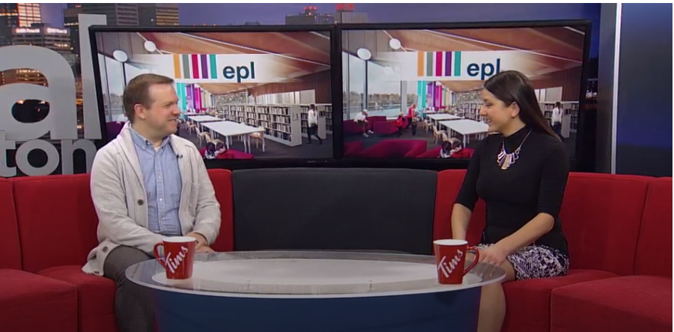
Types of Media Interviews
Notes:
Here’s a snapshot of Senior Marketing consultant on Global morning doing a live TV interview.
If you are on a tv morning show, look at past interviews to get a sense of what it will be like.
How high are the seats? If they are high, ensure skirts are longer
What colour are the seats? Don’t wear anything that clashes
Do your shoes show?
Are there screens for your logo/graphic to appear? You’ll need to provide in advance of your interview
What is the interviewer’s style of interviewing?
Keep from wearing loud jewelry, may be distracting
Wear something easy for the lapel mic to clip onto
Look at the interviewer not the camera – focus on having a conversation

Slide 20
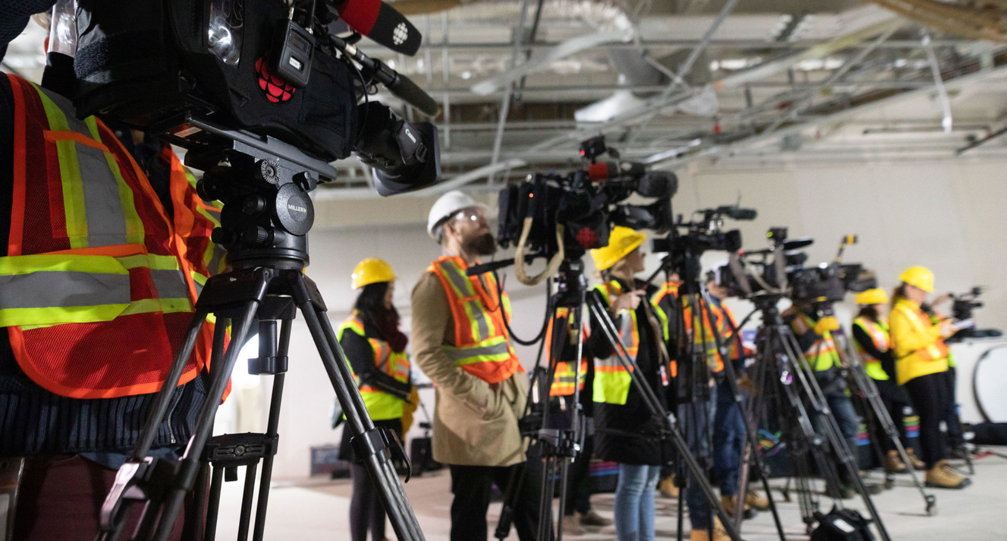
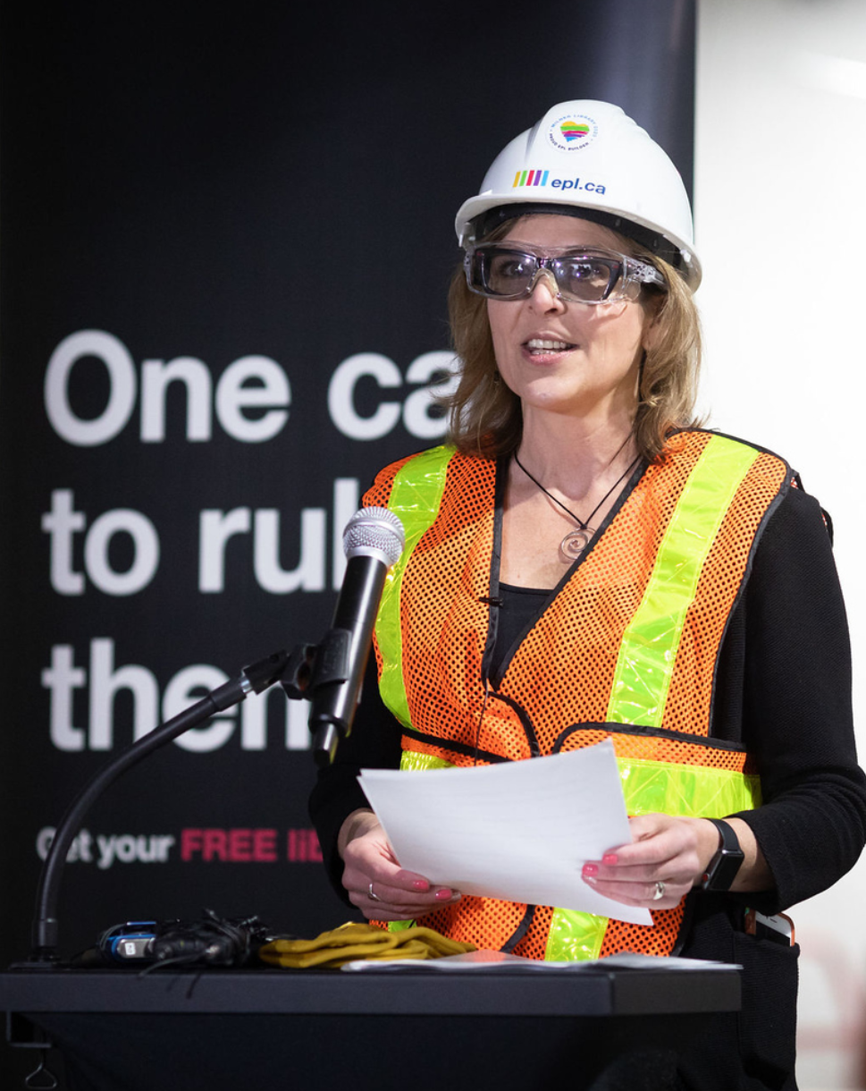
Types of Media Interviews
Notes:
You can be interviewed on location at your branch, or at an event. This can be live or recorded.
This photo is of the media tour led by our CEO to give media a sneak peek into the still-under-construction Milner Library.
If you are inviting media to your location, check it out ahead of time, and review what area would be best (not a lot of clutter, good lighting, room to add a library sign)
In this media sneak peek example, television, radio and print media were present ended with a scrum. Ensure your spokesperson is comfortable with a media scrum. It’s when the spokesperson is crowded by several media with cameras, and mics asking the spokesperson questions.

Slide 21
Types of Media Interviews
Notes:
You can be interviewed on radio live in studio or recorded by phone.
Podcasts are recorded in advance so will be edited to keep the time and can be done in person or via phone/skype.
Find out if there’s a panel discussion.

Slide 22
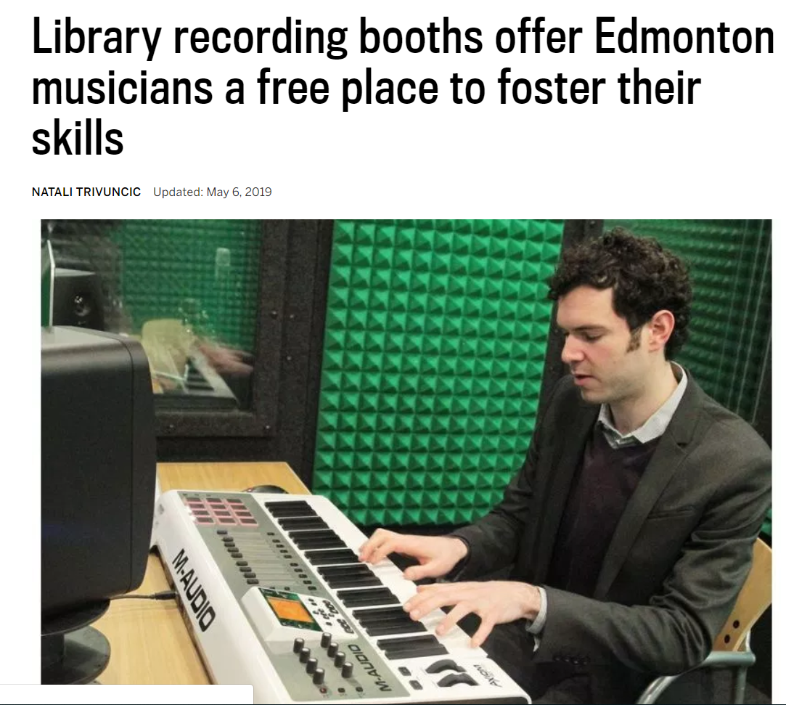
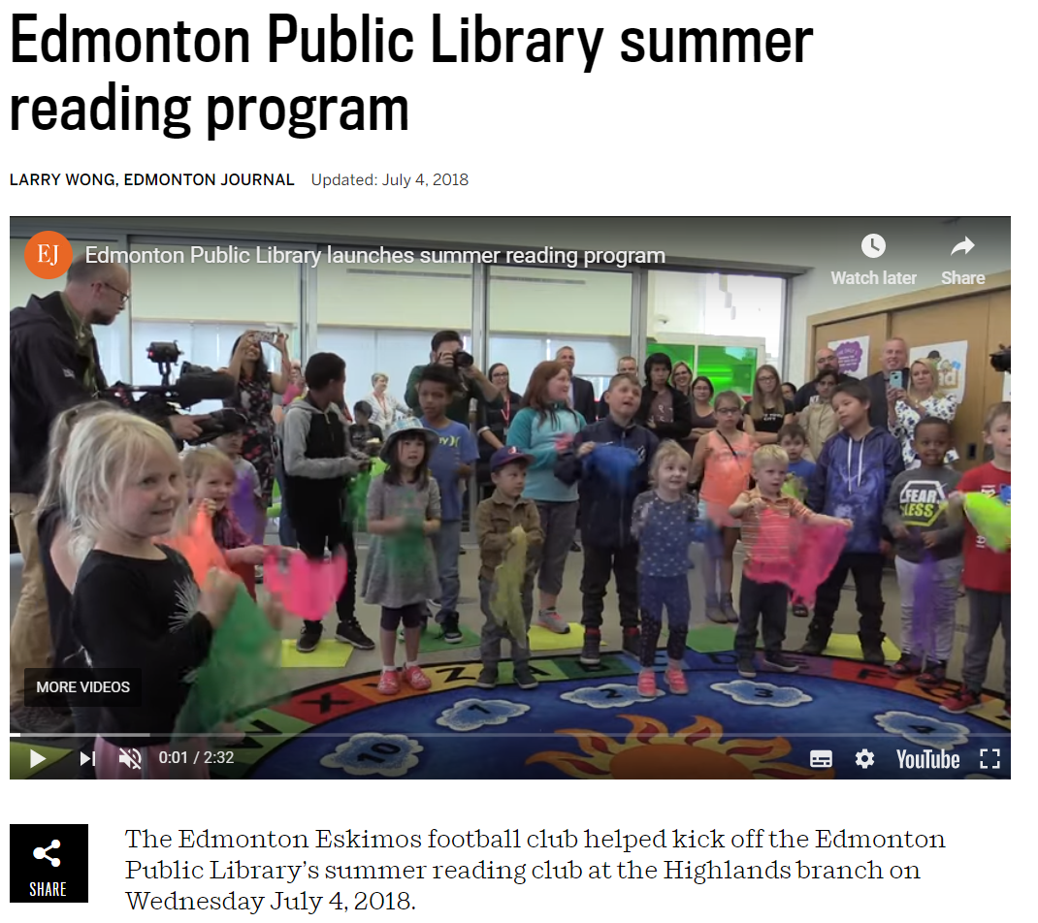
Types of Media Interviews
Notes:
You can be interviewed for a newspaper which will first be posted on the media outlet’s website. Journalist may do interview with videographer recording or a videojournalist will do both.
Even if the interview is for a traditionally print, ask in advance if a video interview will accompany it.
For print media, it’s accepted to ask for questions ahead of time.
Almost always reporters, will end with asking you if there’s anything else you’d like to add. This is where you can emphasize your main message.

Slide 23
Prep for the interview
Arrive on time
Be cordial
Deliver your key message points
Always show enthusiasm and animation
Provide a list of questions you would like to have asked
Notes:
Your Responsibilities
Arrive at an interview on time – that means at least 15 min before the interview
Be cordial to reporters
Deliver your key message points with or without the interviewer’s help
Show enthusiasm and animation at all times
Provide the tv segment producer with a list of questions you would like to have asked, in advance – shorter so they want to ensure they cover your key points

Slide 24
Tip #6: Key Messages
Notes:
Before any interview, prepare your key messages.

Slide 25
What are your key messages?
Write sentences that can stand on their own
Use simple words
Emphasize the positive
Avoid jargon and acronyms
Notes:
Follow these tips to make sure your talking points are clear, effective, and memorable:
Write out sentences that stand on their own
What do you want people to remember? As you would in any presentation, prepare your talking points by identifying your goals first.
Figure out the core message you want publicized and promoted, then use it as a guide to outline the rest of your messages. Stick with something that’s “newsworthy and consistent with your brand.”
Everything you bring up during the media interview should contribute to the core message you’re trying to deliver. If that’s “we have an exciting new service coming out soon,” make sure everything you say will allow the audience to see why that’s true and important for them. You could give them an overview of the service, including a short discussion of its features.
Depending on the type of interview, you will be able to elaborate on your key messages.
Longer recorded interviews for print or on a podcast will give you more time to explain your key messages.
Use simple words
“We manage the program” not “We oversee the management of the program”
“We analyze the data” not “We conduct an analysis of the data”.
Emphasize the positive – convey the benefits.
Avoid jargon and acronyms
“Alberta Reader’s Choice Award” not ARCA
“Young Reader’s Choice Award” not YRCA

Slide 26
Key messages
Public libraries are advanced civic institutions that perform critical functions to improve communities’ access and understanding of technological innovation.
Notes:
This is an example of a key message before it’s been edited. [Read the KM]
Too long, some of it can be simplified. And it’s a bit of a tongue twister.

Slide 27
Key messages
Public libraries are constantly innovating to meet community needs through hands-on experiences with technology.
Notes:
Revised key message, easier to say and understand

Slide 28
Key messages
Introduce recognized speaker and topic
Date of the presentation
Ticket on sale date
Notes:
For a media interview about an upcoming speaker presentation, your goal may be to introduce the speaker, topic of the presentation and key dates.

Slide 29
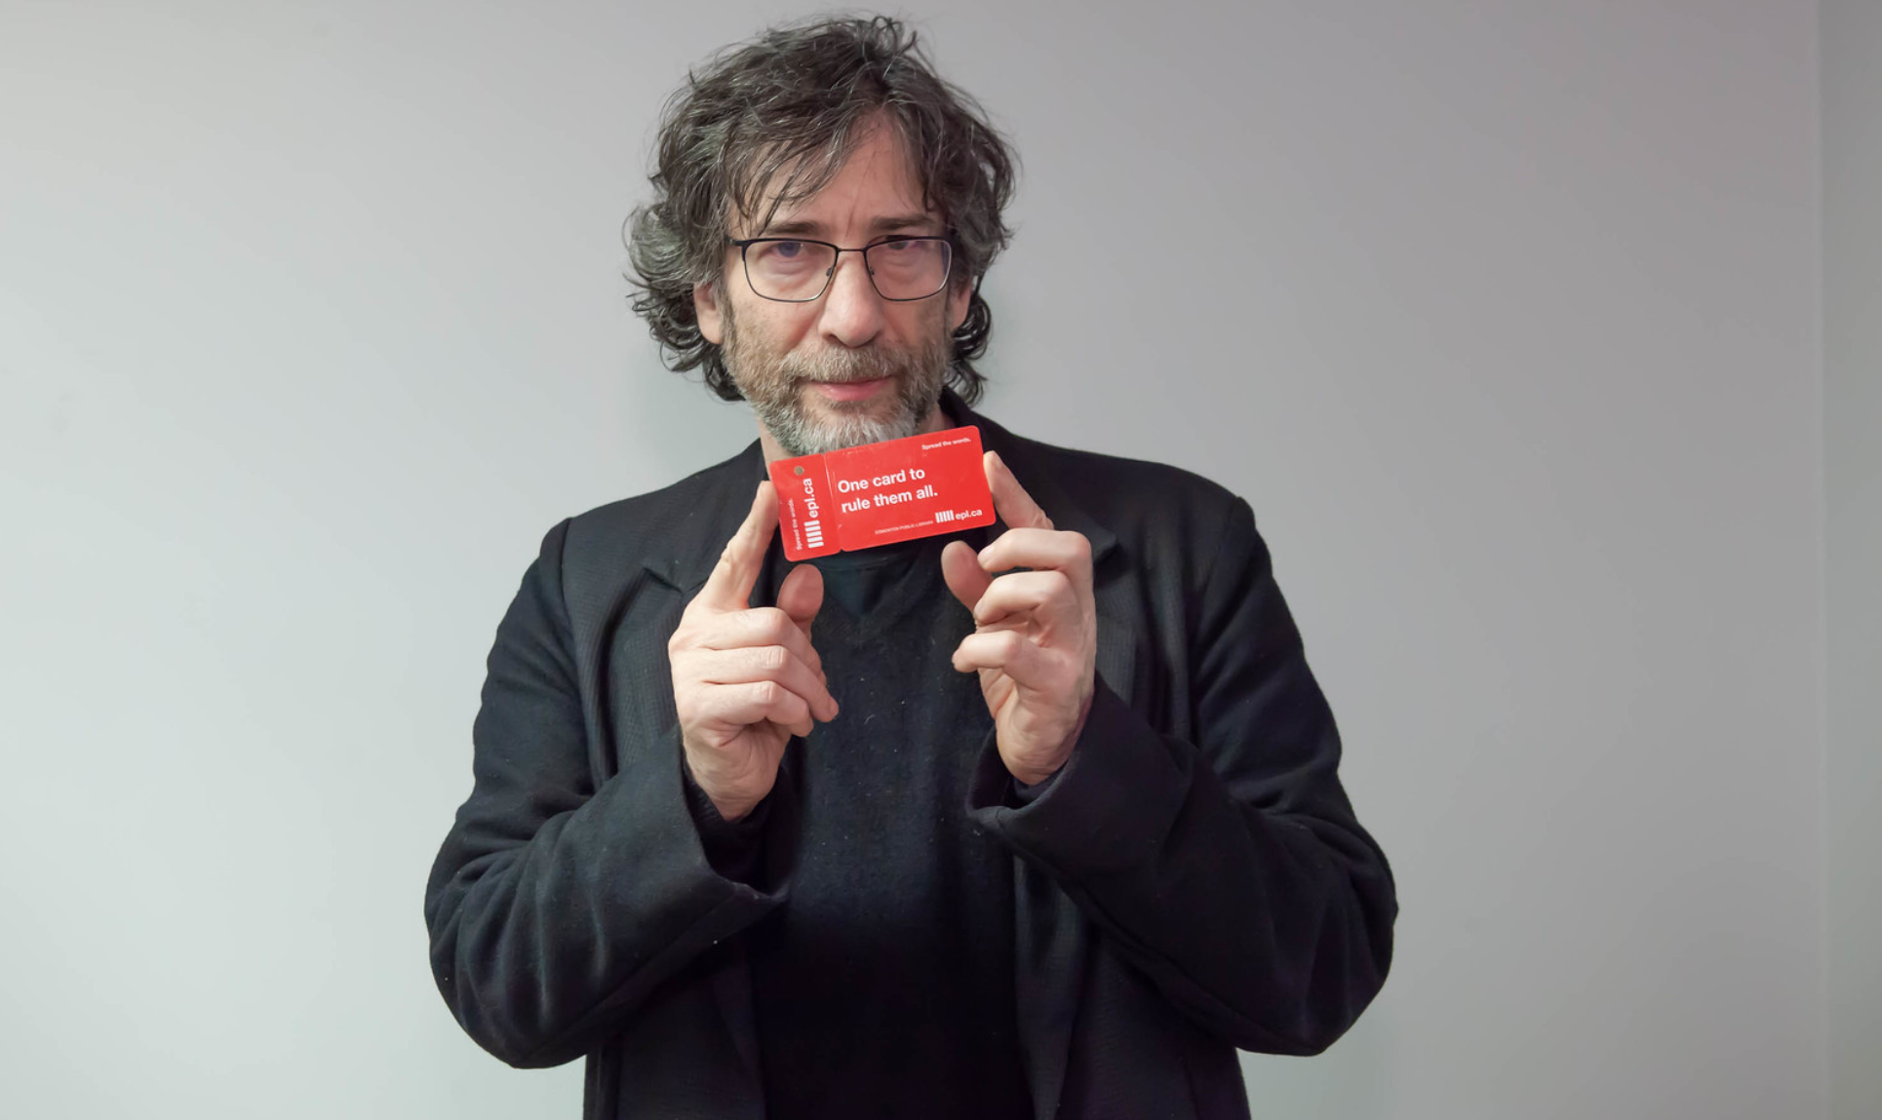
Key messages
Notes:
Edmonton Public Library (EPL) in partnership with the University of Alberta Libraries present Neil Gaiman on November 13, 2018 at the Shaw Conference Centre.
Mr. Gaiman will discuss writing and his creative process, and the impact libraries have had on his life and career.
EPL cardholders will be able to purchase tickets to the event starting on Wednesday, September 12 at 10am on Eventbrite.

Slide 30
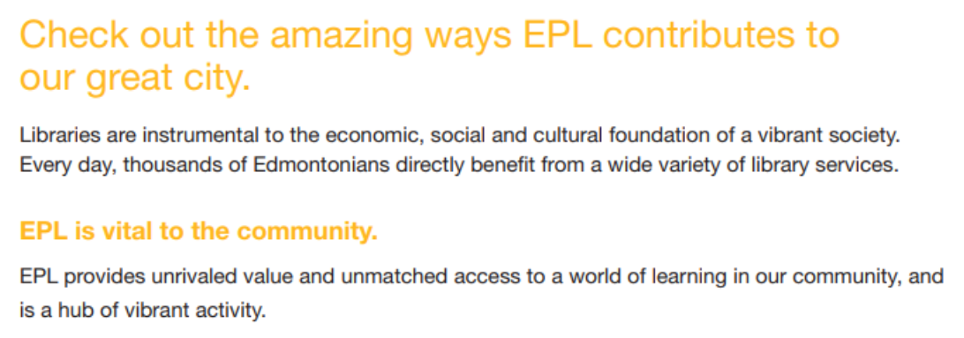
Key messages
Notes:
Use key messages that you share with media in interviews, media releases in your advocacy documents that you give to political candidates and/or trustees.
This is an advocacy booklet that we distributed to municipal candidates in 2017 sharing EPL’s impact in the community.
It included our key messages and KPIS with the purpose of keeping us top of mind and supporting the library.

Slide 31
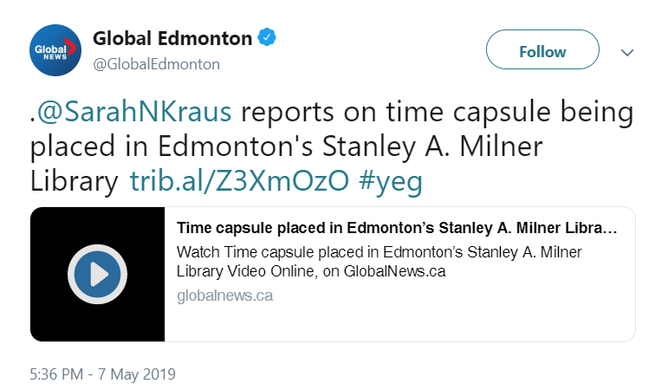
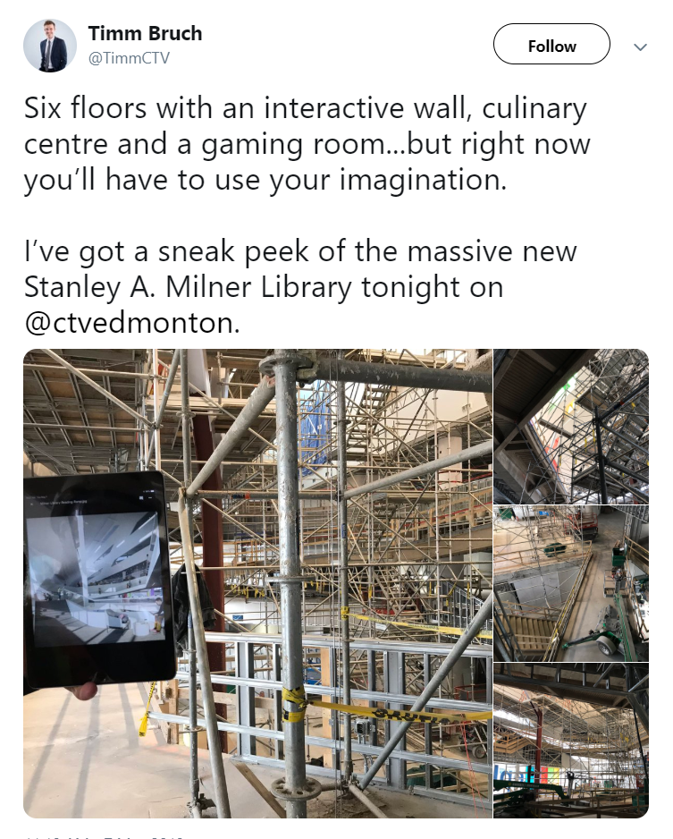
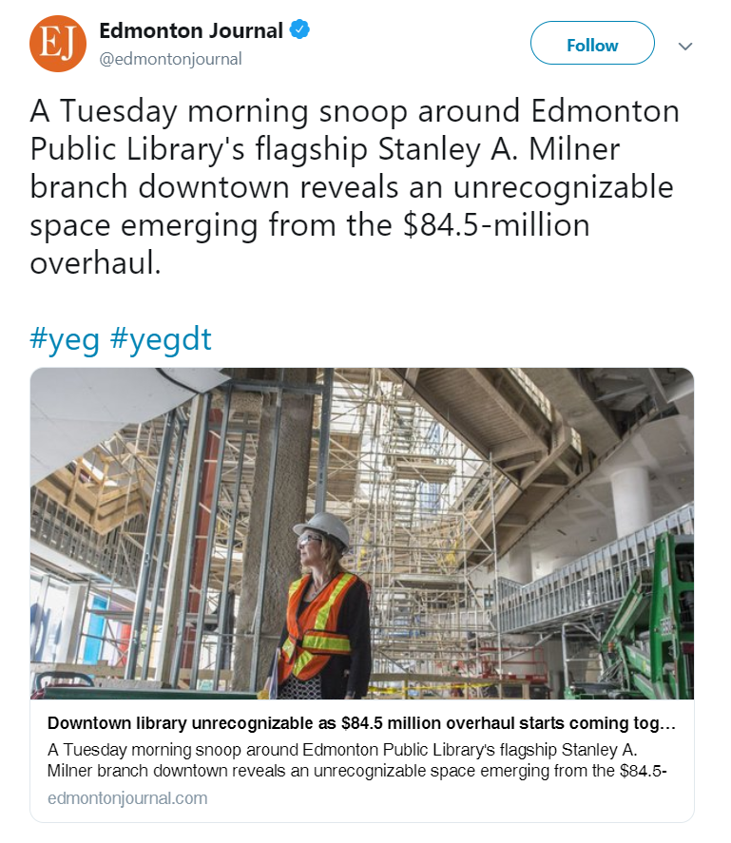
Key messages
Notes:
Use key messages to respond to social media posts, questions generated from media coverage.

Slide 32
Bridging
“It’s important for people to know that…”
“What we have to look at is…”
“The key point to remember is…”
“I’d also like to add that…”
“This is an important point because…”
“Before we continue, let me emphasize that…”
Notes:
BRIDGING: If the interviewer asks you a question that isn’t clear or is negative, do not avoid it, as it will only be asked again. Instead, “bridge” the conversation to a positive aspect of the issue. This is an important factor in any interview, because it allows you to control the focus and establish your message.
It’s important for people to know that…the project is on time and on budget.
What we have to look at is…the community that will be served with these improved services.
The key point to remember is…
I’d also like to add that…
This is an important point because…
Before we continue, let me emphasize that…
https://lindareedenever.com.au/64-bridging-statements-can-use-media-interview/

Slide 33
Tip #7: Brand Integration
Notes:
To take your key messages further, it’s also important to include elements of your brand identity. Make use of adjectives that you often use to describe your brand.

Slide 34
Brand story
Create
Innovative
Freedom
Idea champions
Discover
Learn
Gathering place
We share.
Customer experience
FUN
Notes:
[Read the phrases/words.]
Here are words/phrases that EPL uses. We try to incorporate these words when developing key messages and in EPL communications.
Apple commonly uses words like “innovative” and “next generation” whenever they announce or launch a new product. As you work on your talking points, think back to your brand story and make it a prominent point throughout the interview.
For recorded interviews, such as tv, podcast, radio, interviewers will look for sound bites. Think of potential sound bites in advance that reflect your key messages and media will look for these to use in promoting the segment.

Slide 35
Tip #8: Media Kits
Notes:
A media kit is a package (printed or digital) that contains information about your library, event or program. The point of the media kit is to interest a journalist to write an article or do an interview.

Slide 36
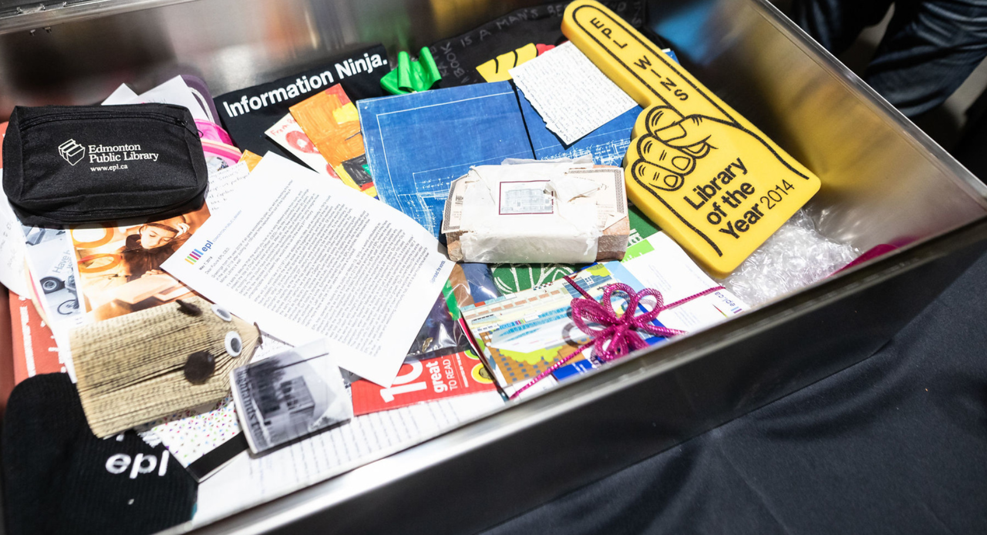
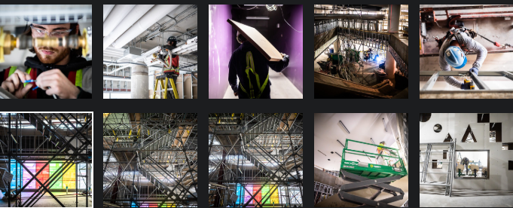
What’s in a media kit?
Notes:
Contact details: Include the contact details of the person who can be interviewed or coordinate the interview.
A media release: Journalists will want to know what is going on and have some details about the event. Your media release should include quotes from the person who is available for interview.
Images: Make sure you put some images in your media kit that journalists can use for their stories. Most journalists require high-resolution images, but if there isn’t enough space put them on as low-resolution and let the journalists know they can contact you for high-resolution if needed. These can go on a usb.

Slide 37
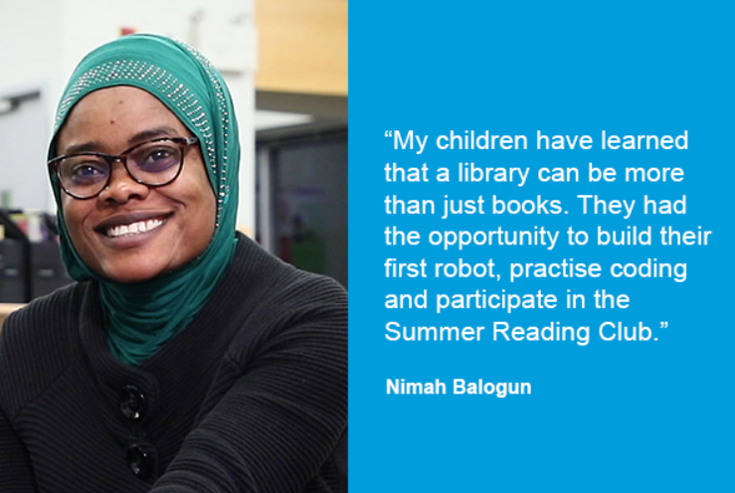
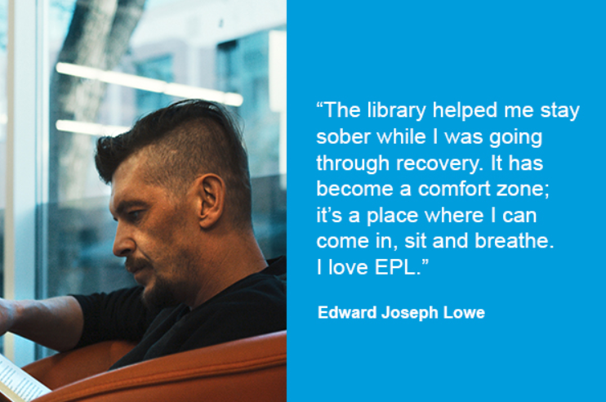
What’s in a media kit?
Notes:
Testimonials from customers: shows the impact of your library – brings your key messages to life. Use your best testimonials to demonstrate your credibility.
Nimah – Newcomer, single mom, kids learned robotics and participated in Summer Reading Club.
Joe - library helped him with his sobriety, learned photoshop, logic pro, made a song that he turned to a musical piece used at the Hope Mission’s Gala.

Slide 38
What’s in a media kit?
Notes:
Annual report: Share how your library is doing, infographics are quick and easy to read. Include other interesting and Did you know type of facts.
Did you know that customers downloaded 3.7 million e-resources in 2018?
That’s over 10,000 downloads a day!
Did you know that 275, 272 Edmontonians used their library card?

Slide 39
Tip #9 : Track Media Coverage
Notes:
Important to track your media coverage and measure impact of everything you do.
As non-profits, with limited advertising budgets, we rely on media coverage to share/distribute news and updates to the communities we serve.

Slide 40
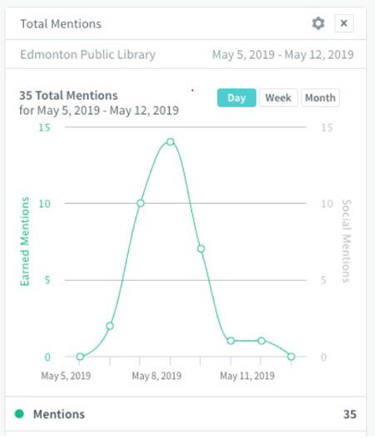
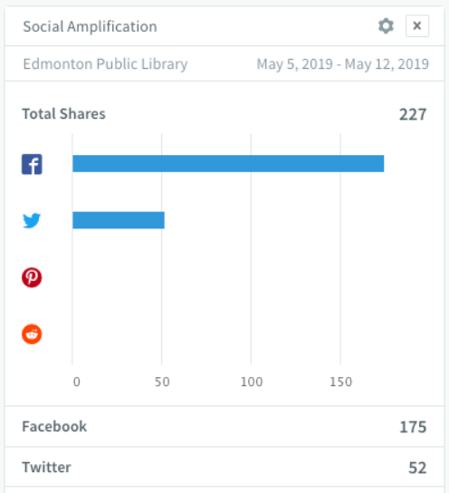
Track media coverage
Notes:
Here’s an example of how EPL is testing the tracking of media coverage. This coverage is from the media tour that we hosted in May that gave media a sneak peek into Milner Library.
Results are coming from a tool called Trendkite – media analytics tool we are testing
227 Shares on Facebook ad Twitter
Total of 35 mentions peaking on May 8
Comparison for media mentions:
Q1, 2019– 41
Capilano, Calder, Heritage Valley and Londonderry Grand opening combined – 20 mentions
Receiving great coverage from the event
This way you will always be privy to the media mentions surrounding your brand and can choose to share the coverage that you feel is most impactful to your brand.

Slide 41
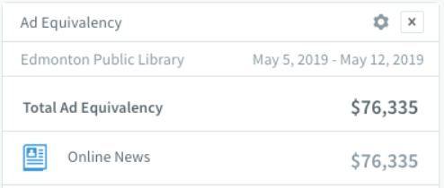
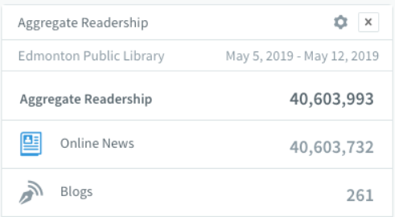
Track media coverage
Notes:
Total ad equivalency: $76, 335
Ad equivalency calculates earned media coverage, or editorial coverage would cost if it were advertising.
Readership 40, 603, 993

Slide 42
Tip #10: Develop an Online Media Room
Notes:
Your online media room is part if your website.

Slide 43
Online Media Room
One-stop shop for library information
Boosts credibility
Branding benefits
Notes:
One stop shop for library information and news- includes latest announcements, media releases, contact information, media newsletters
Boost credibility by sharing your media coverage. Establish support for the work you are doing and can lead to other media coverage and stories. Use social media to share or re-share the coverage from media outlets that you feel is most aligned with your key messages.
Branding benefits because it is regularly updated, it allows your audience to know what your library is up to and what direction your brand is headed. Perhaps it’s a focus on digital literacy, events featuring thought leaders or a new partnership.

Slide 44
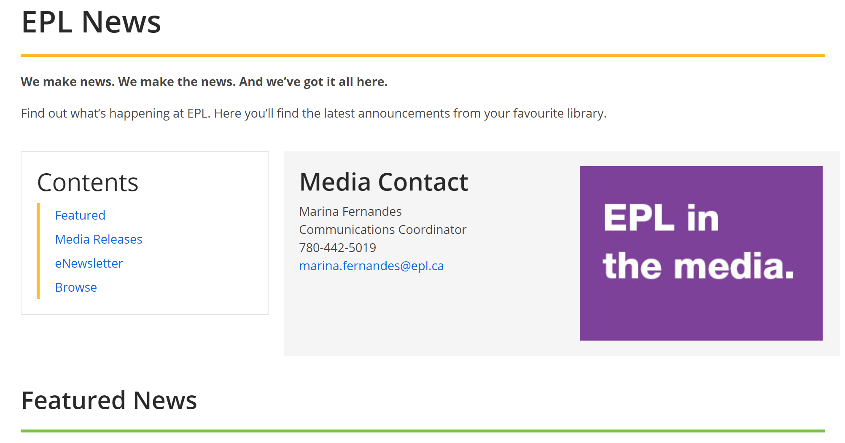
Online Media Room
Notes:
Snap shot of EPL’s online media room

Slide 45
Bonus Tip: Influencer Collaboration
Notes:
Influencers in social media are people who have built a reputation for their knowledge and expertise on a particular topic. They make regular posts about that topic on their preferred social media channels and generate engagement from enthusiastic people who pay close attention to their views.

Slide 46
What is an influencer?
Individuals who have the power to affect decisions of others because of authority, knowledge or relationship with their audience.
They have a particular niche, which they actively engage with.
Notes:
Types of Influencers
The majority of influencers fit into the following categories:
Celebrities like Oprah Reese Witherspoon and her book club
Industry experts and thought leaders like Brene Brown
Bloggers and content creators like the Book Riot
Micro Influencers who could be in your office or neighbourhood.
The bulk of social influencer marketing today occurs in social media, predominantly with micro influencers.
Micro-influencer marketing is the use of what many people would consider “everyday people” to promote specific products on social media. Those products can range from a book to food or a new service.
One of the reasons why micro-influencer marketing has become an option is that have people want advice and recommendations from other people that they trust.
Audience count matters less when looking at micro-influencers than it does when looking at big-name or macro-influencers. In fact, there’s no firm definition when it comes to how many followers make someone a micro-influencer. Some effective micro-influencers have just a few hundred, some have a thousand, and others have tens of thousands.
What matters most is engagement. As AdWeek showed, engagement actually tends to drop the more followers an influencer has. Those with audiences smaller than 1,000 typically have engagement rates of around 15 percent. That means a person with 1,000 engaged fans might earn 150 likes on each post.
https://izea.com/2017/06/12/micro-influencers-101/

Slide 47
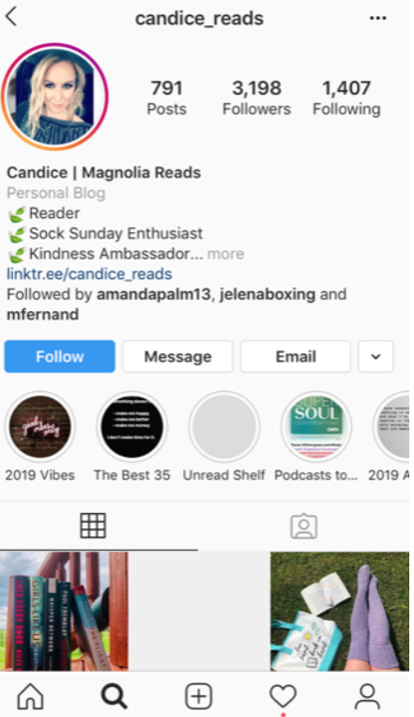
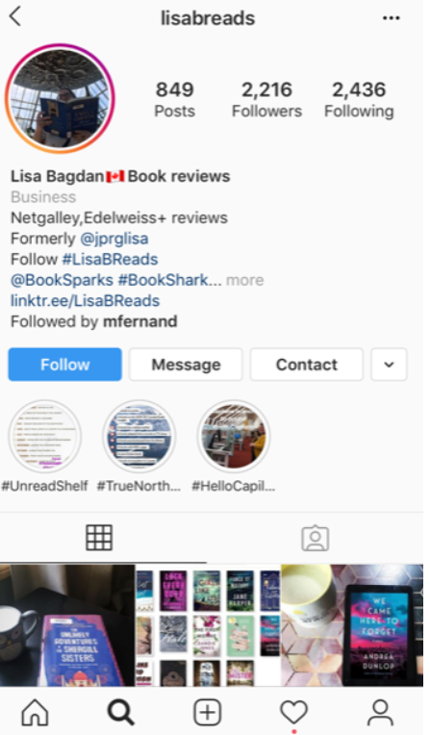
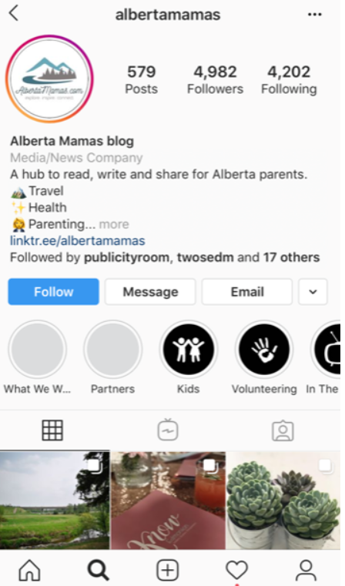
Influencer x EPL Collaboration
Notes:
Partnered with 3 micro infuencers for CPL GO. Loved books and the library.
Goal was to get min 10% engagement with their stories.
Since we aren’t on IG, it was a way for us to reach that audience.

Slide 48
Media Relations Top 10
Anna Alfonso
anna.alfonso@epl.ca

